Slide 1

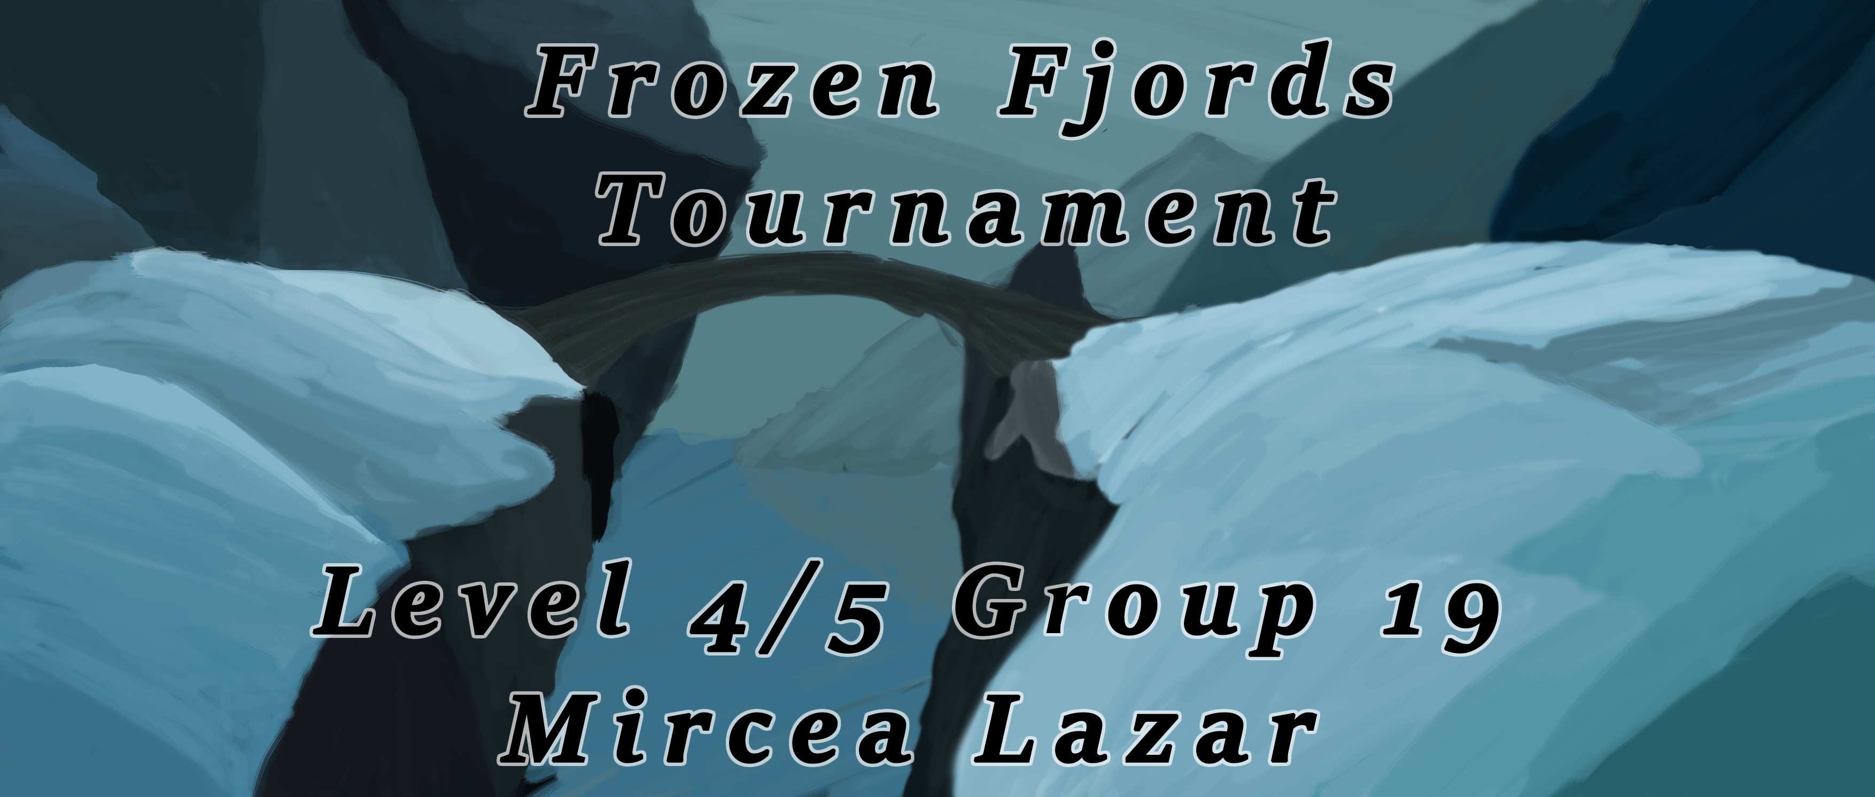

Slide 2
The Strong Points:
S
Focus on Balance and Symmetry
High interactivity between players
Meaningful Choice
Everything merges and creates emotion.

Slide 3
Main Challenges and Mechanics:
S
Physical Skill > Physical Challenge > Twitch Mechanic.
Mental Skill > Strategical Challenge >Meaningful Choice.
Interaction
Decision
Precision

Slide 4
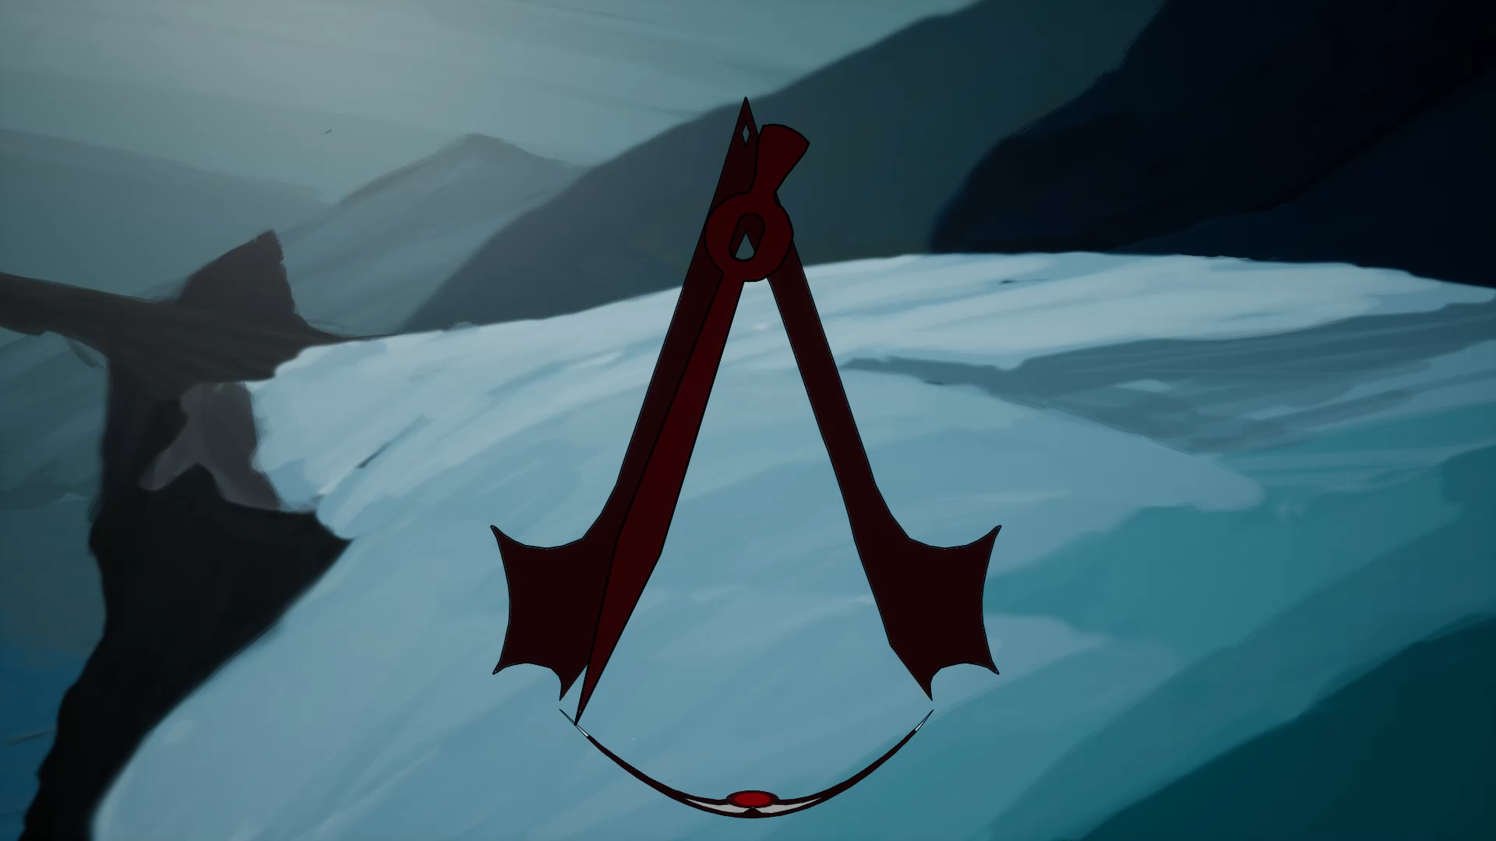
Twitch Mechanic: Precision
L
Clear Goal
Fair starting chance
Easy to Learn & Play
Hard to Master

Slide 5
Mental Skill: Meaningful Choice.
L
Moderate Damage (fixed)
Medium Attacks
Least Damage
(variable)
Light Attacks
Heavy
Attacks
Most Damage
(variable)
Difficulty Modifier
(pendulum speed)

Slide 6
Mental Skill: Difficulty Modifier.
S
Friendly Heavy
Attacks
&
Enemy
Light
Attacks
Enemy Heavy
Attacks
&
Friendly
Light
Attacks
Friendly Modifier
Friendly Light Attacks
&
Enemy
Heavy
Attacks
Enemy Light Attacks
&
Friendly
Heavy
Attacks
Enemy Modifier

Slide 7
Interactivity:
M
Difficulty Modifiers Creates Interactivity.
The Players have to invent a strategy.
Any strategy can be ruined by the opponent.
The interactivity evokes upon the emotions of Fiero and Schadenfreude

Slide 8
Balancing
S
The Modifiers and Damage are applied at the end of the round.
Player 1 has no advantage over player 2.
Damage values for the variable attacks are predefined.

Slide 9
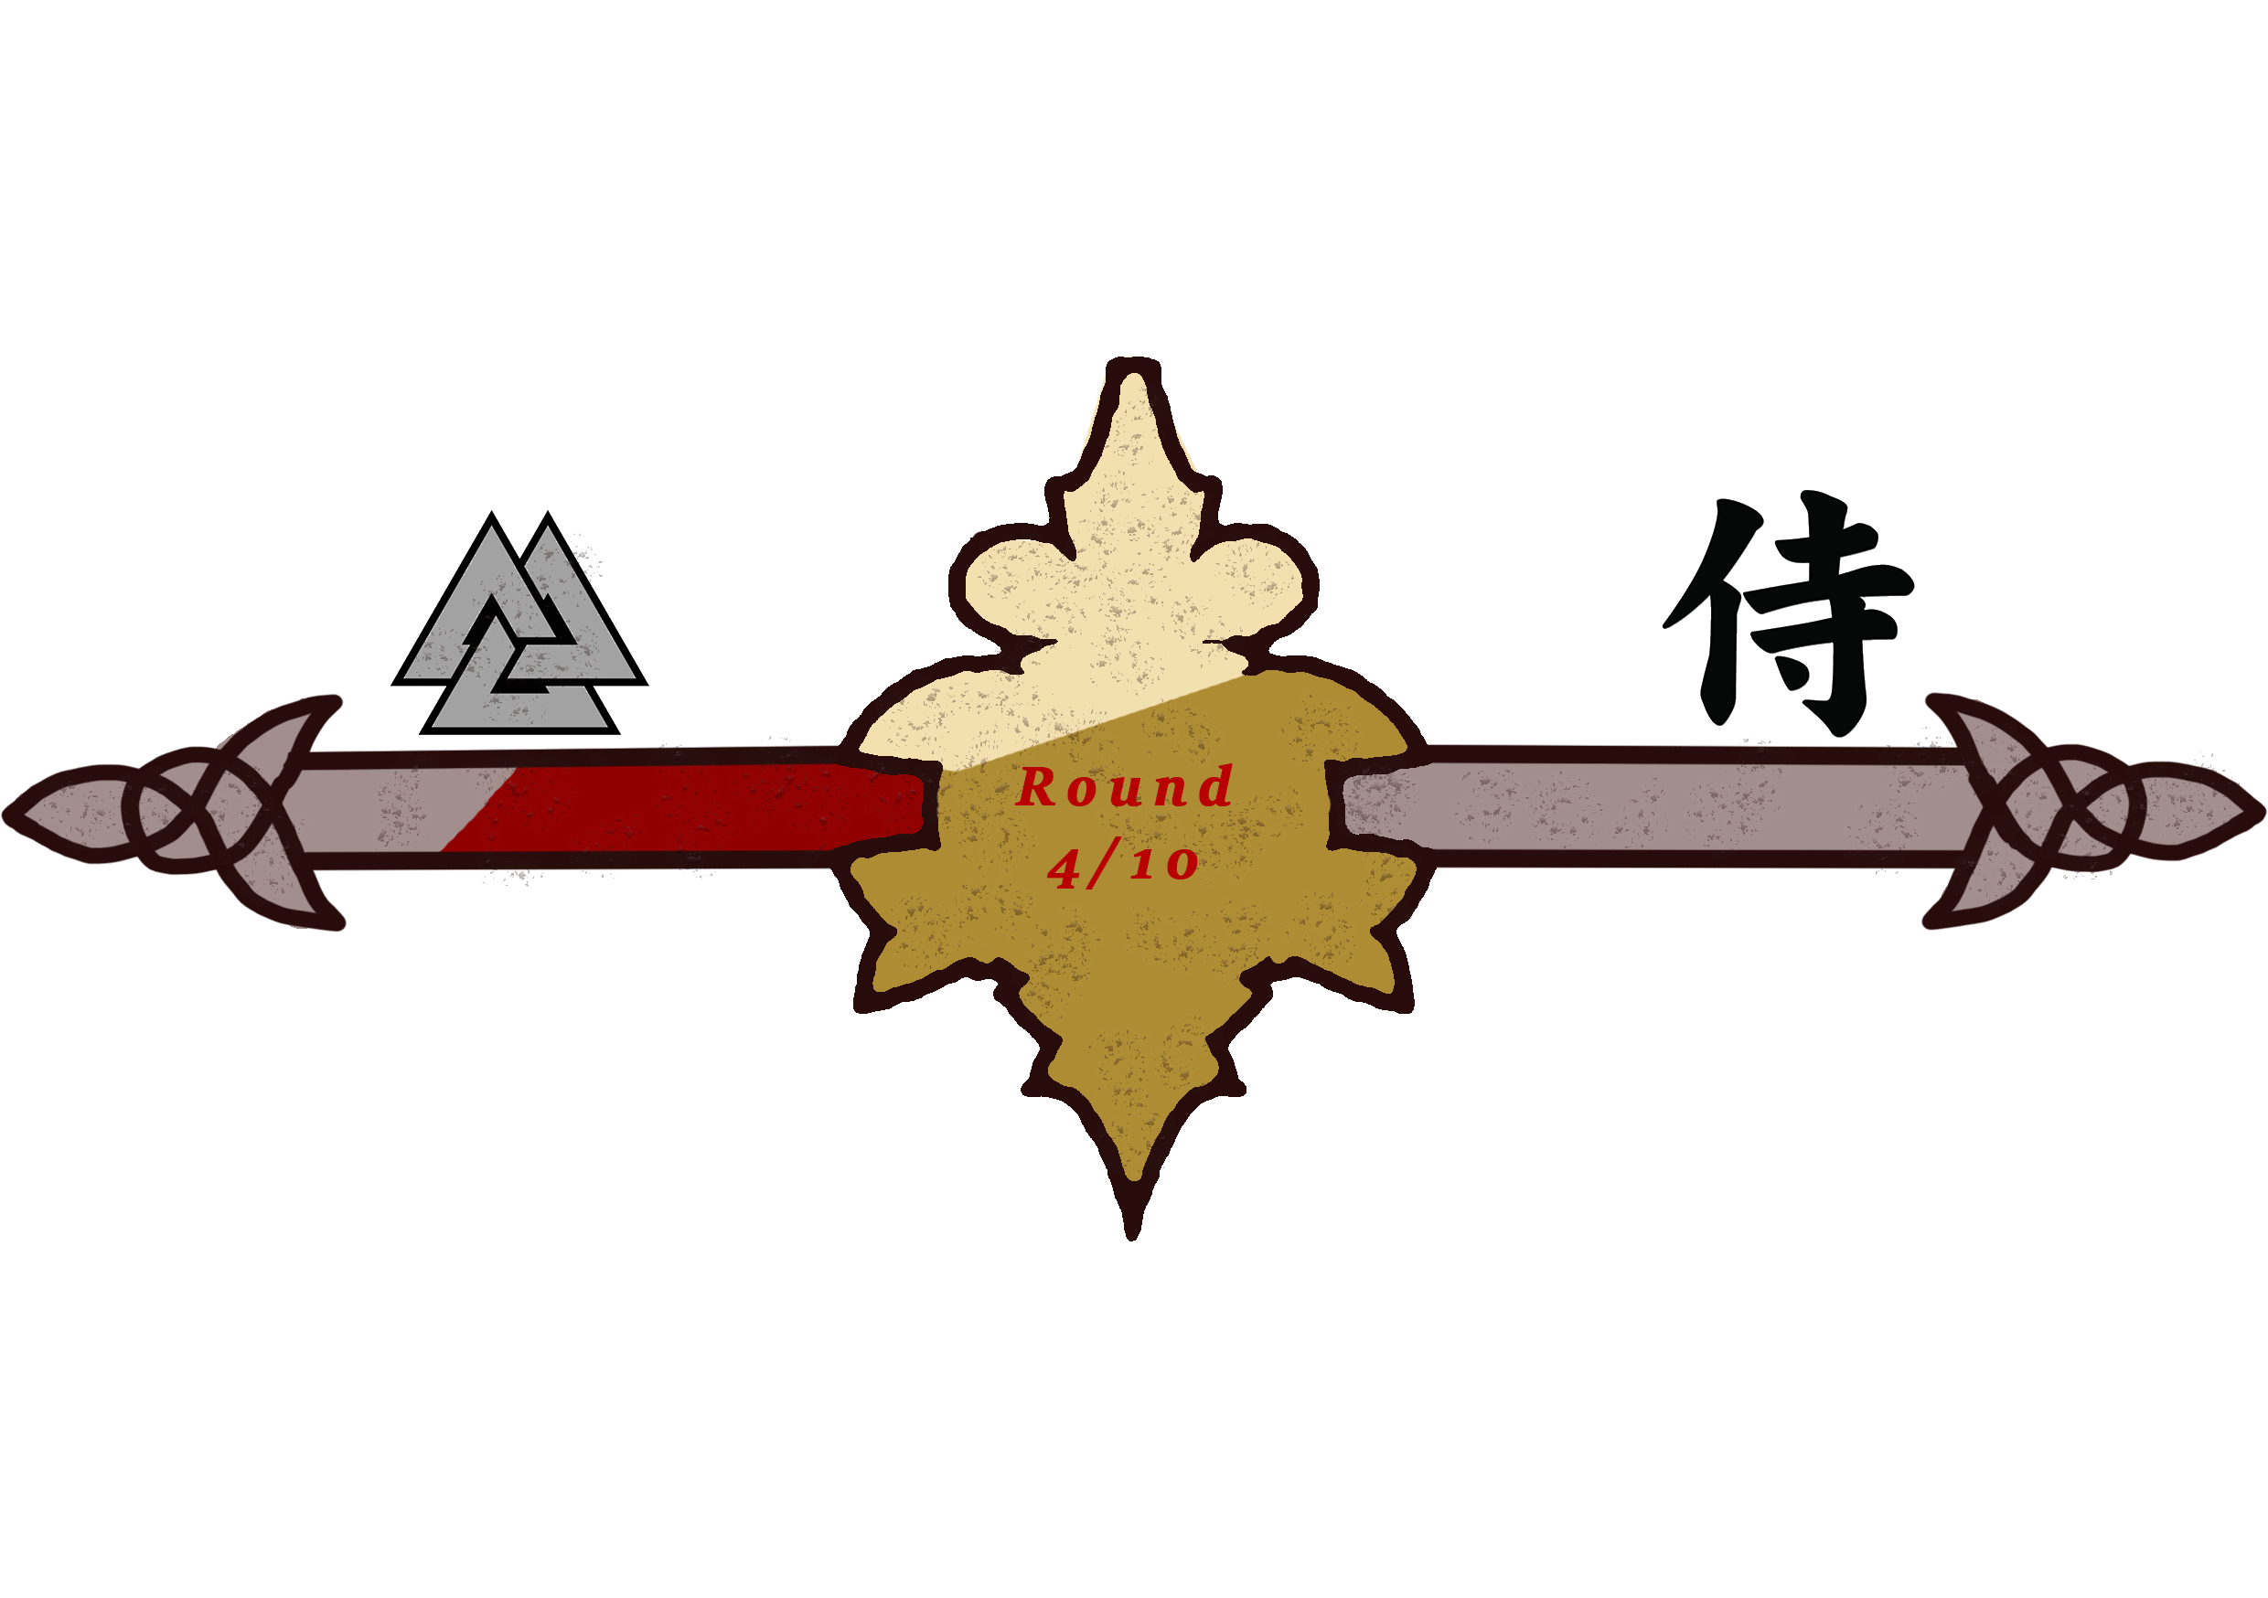
Win & Lose Conditions:
M

Slide 10
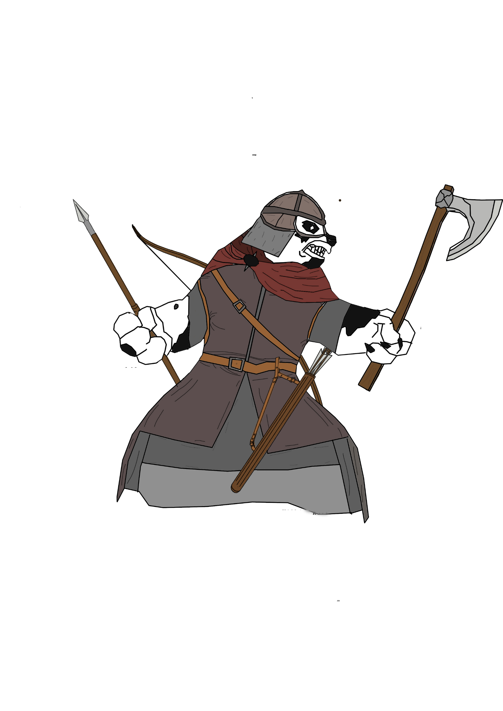
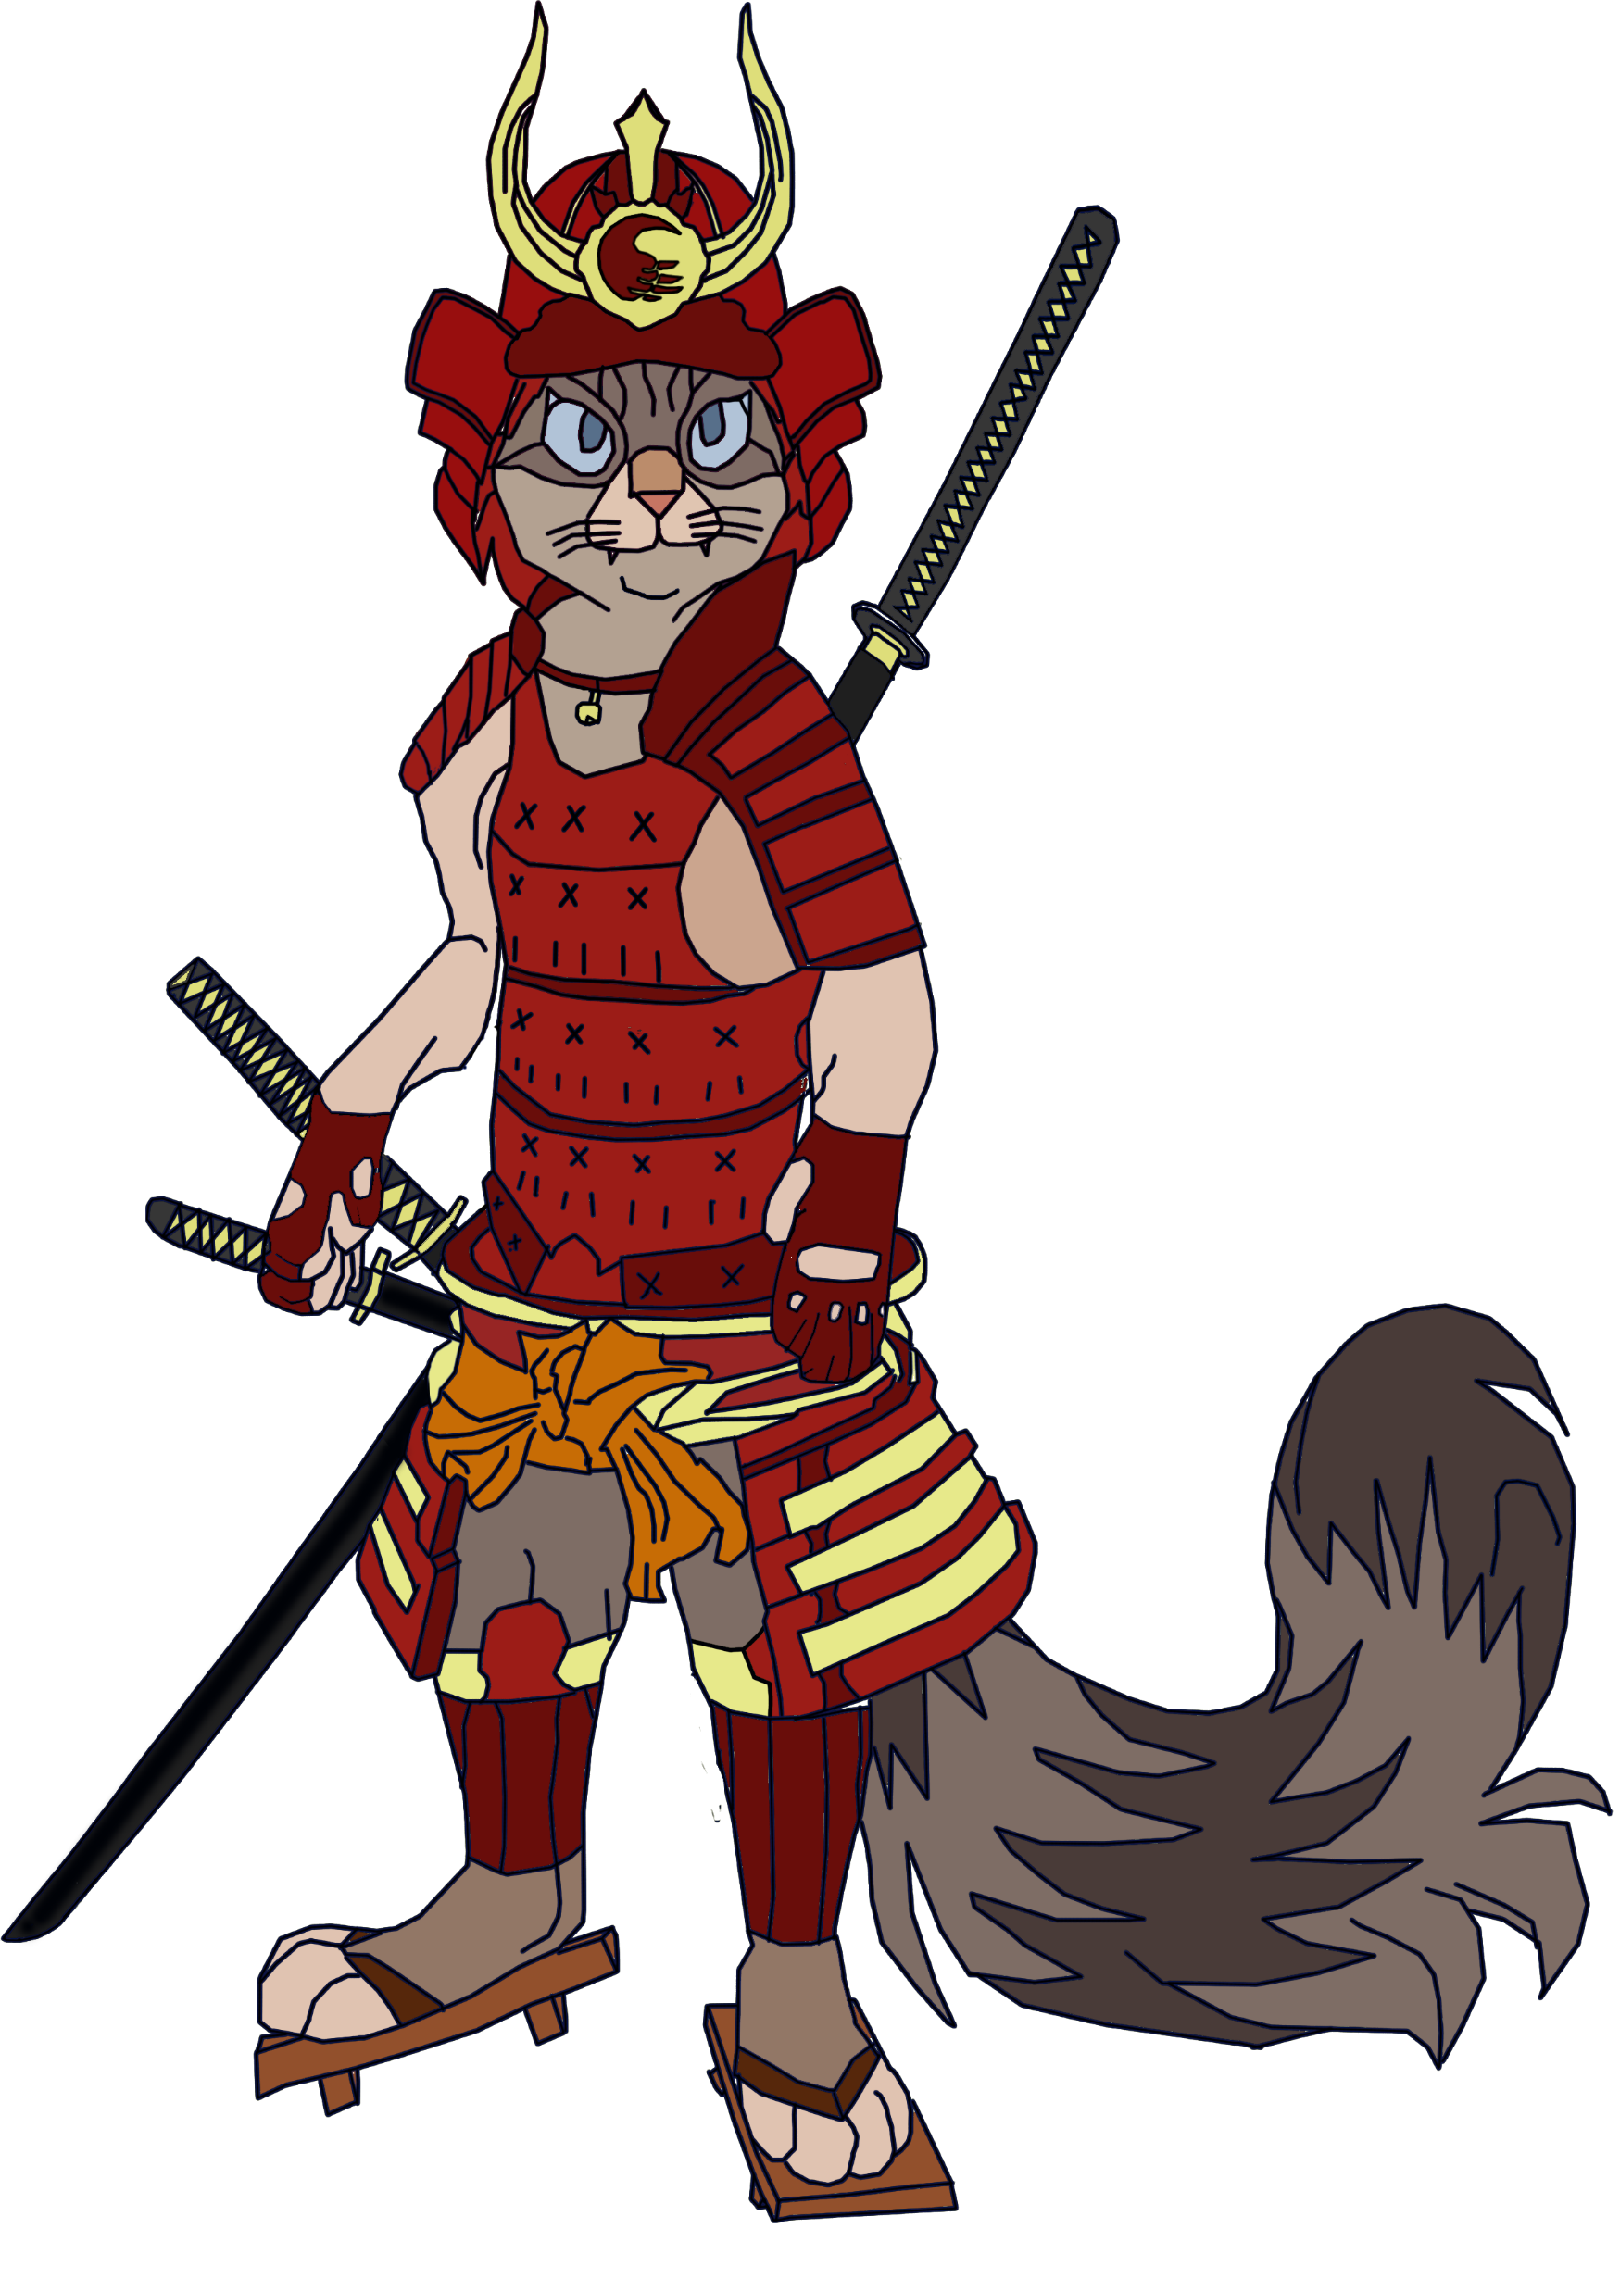
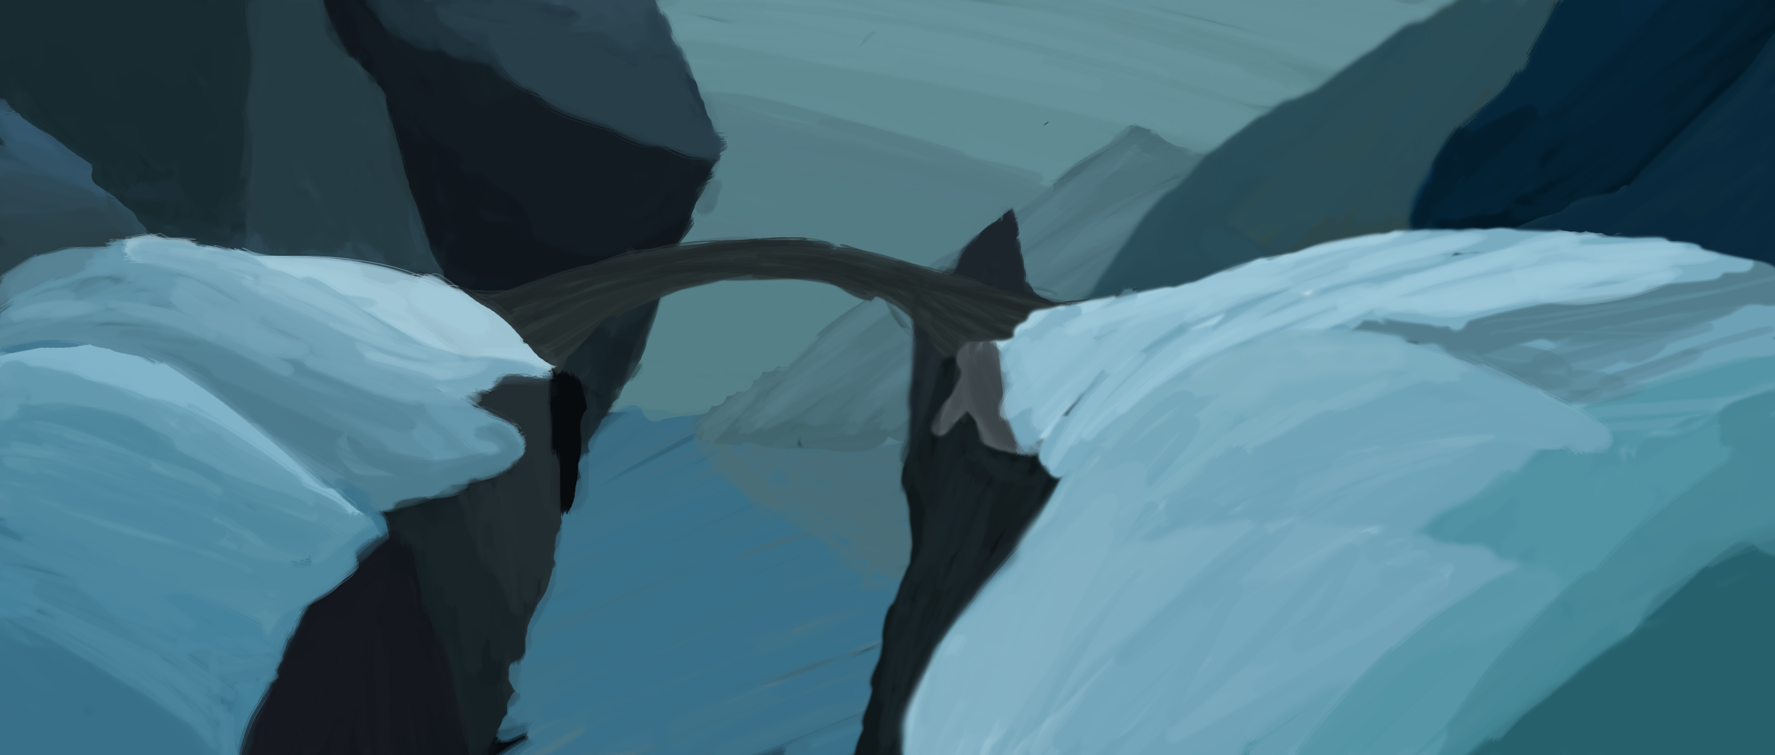

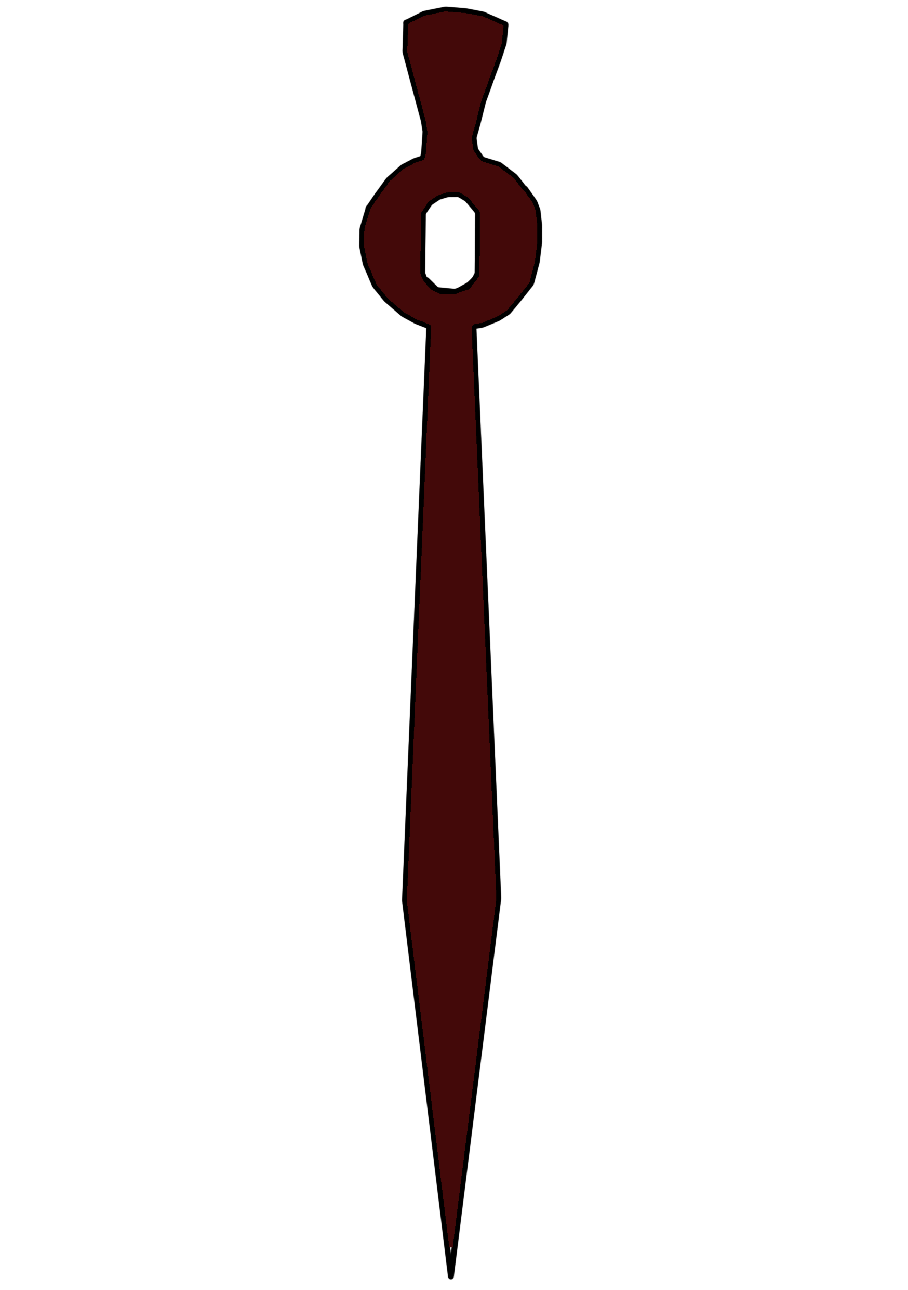
Theme & Aesthetics:
S

Slide 11
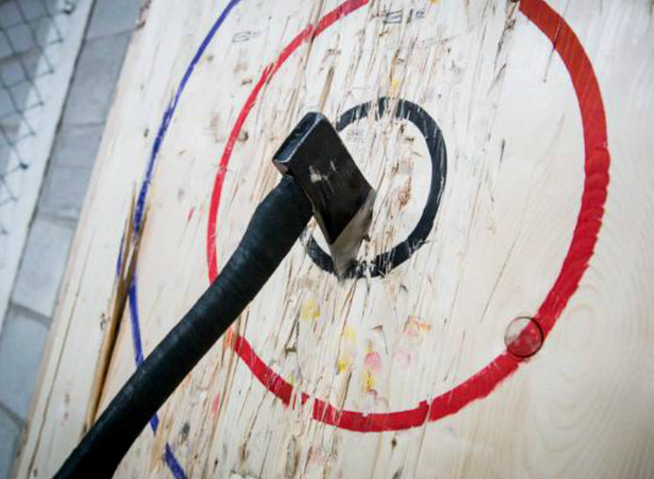
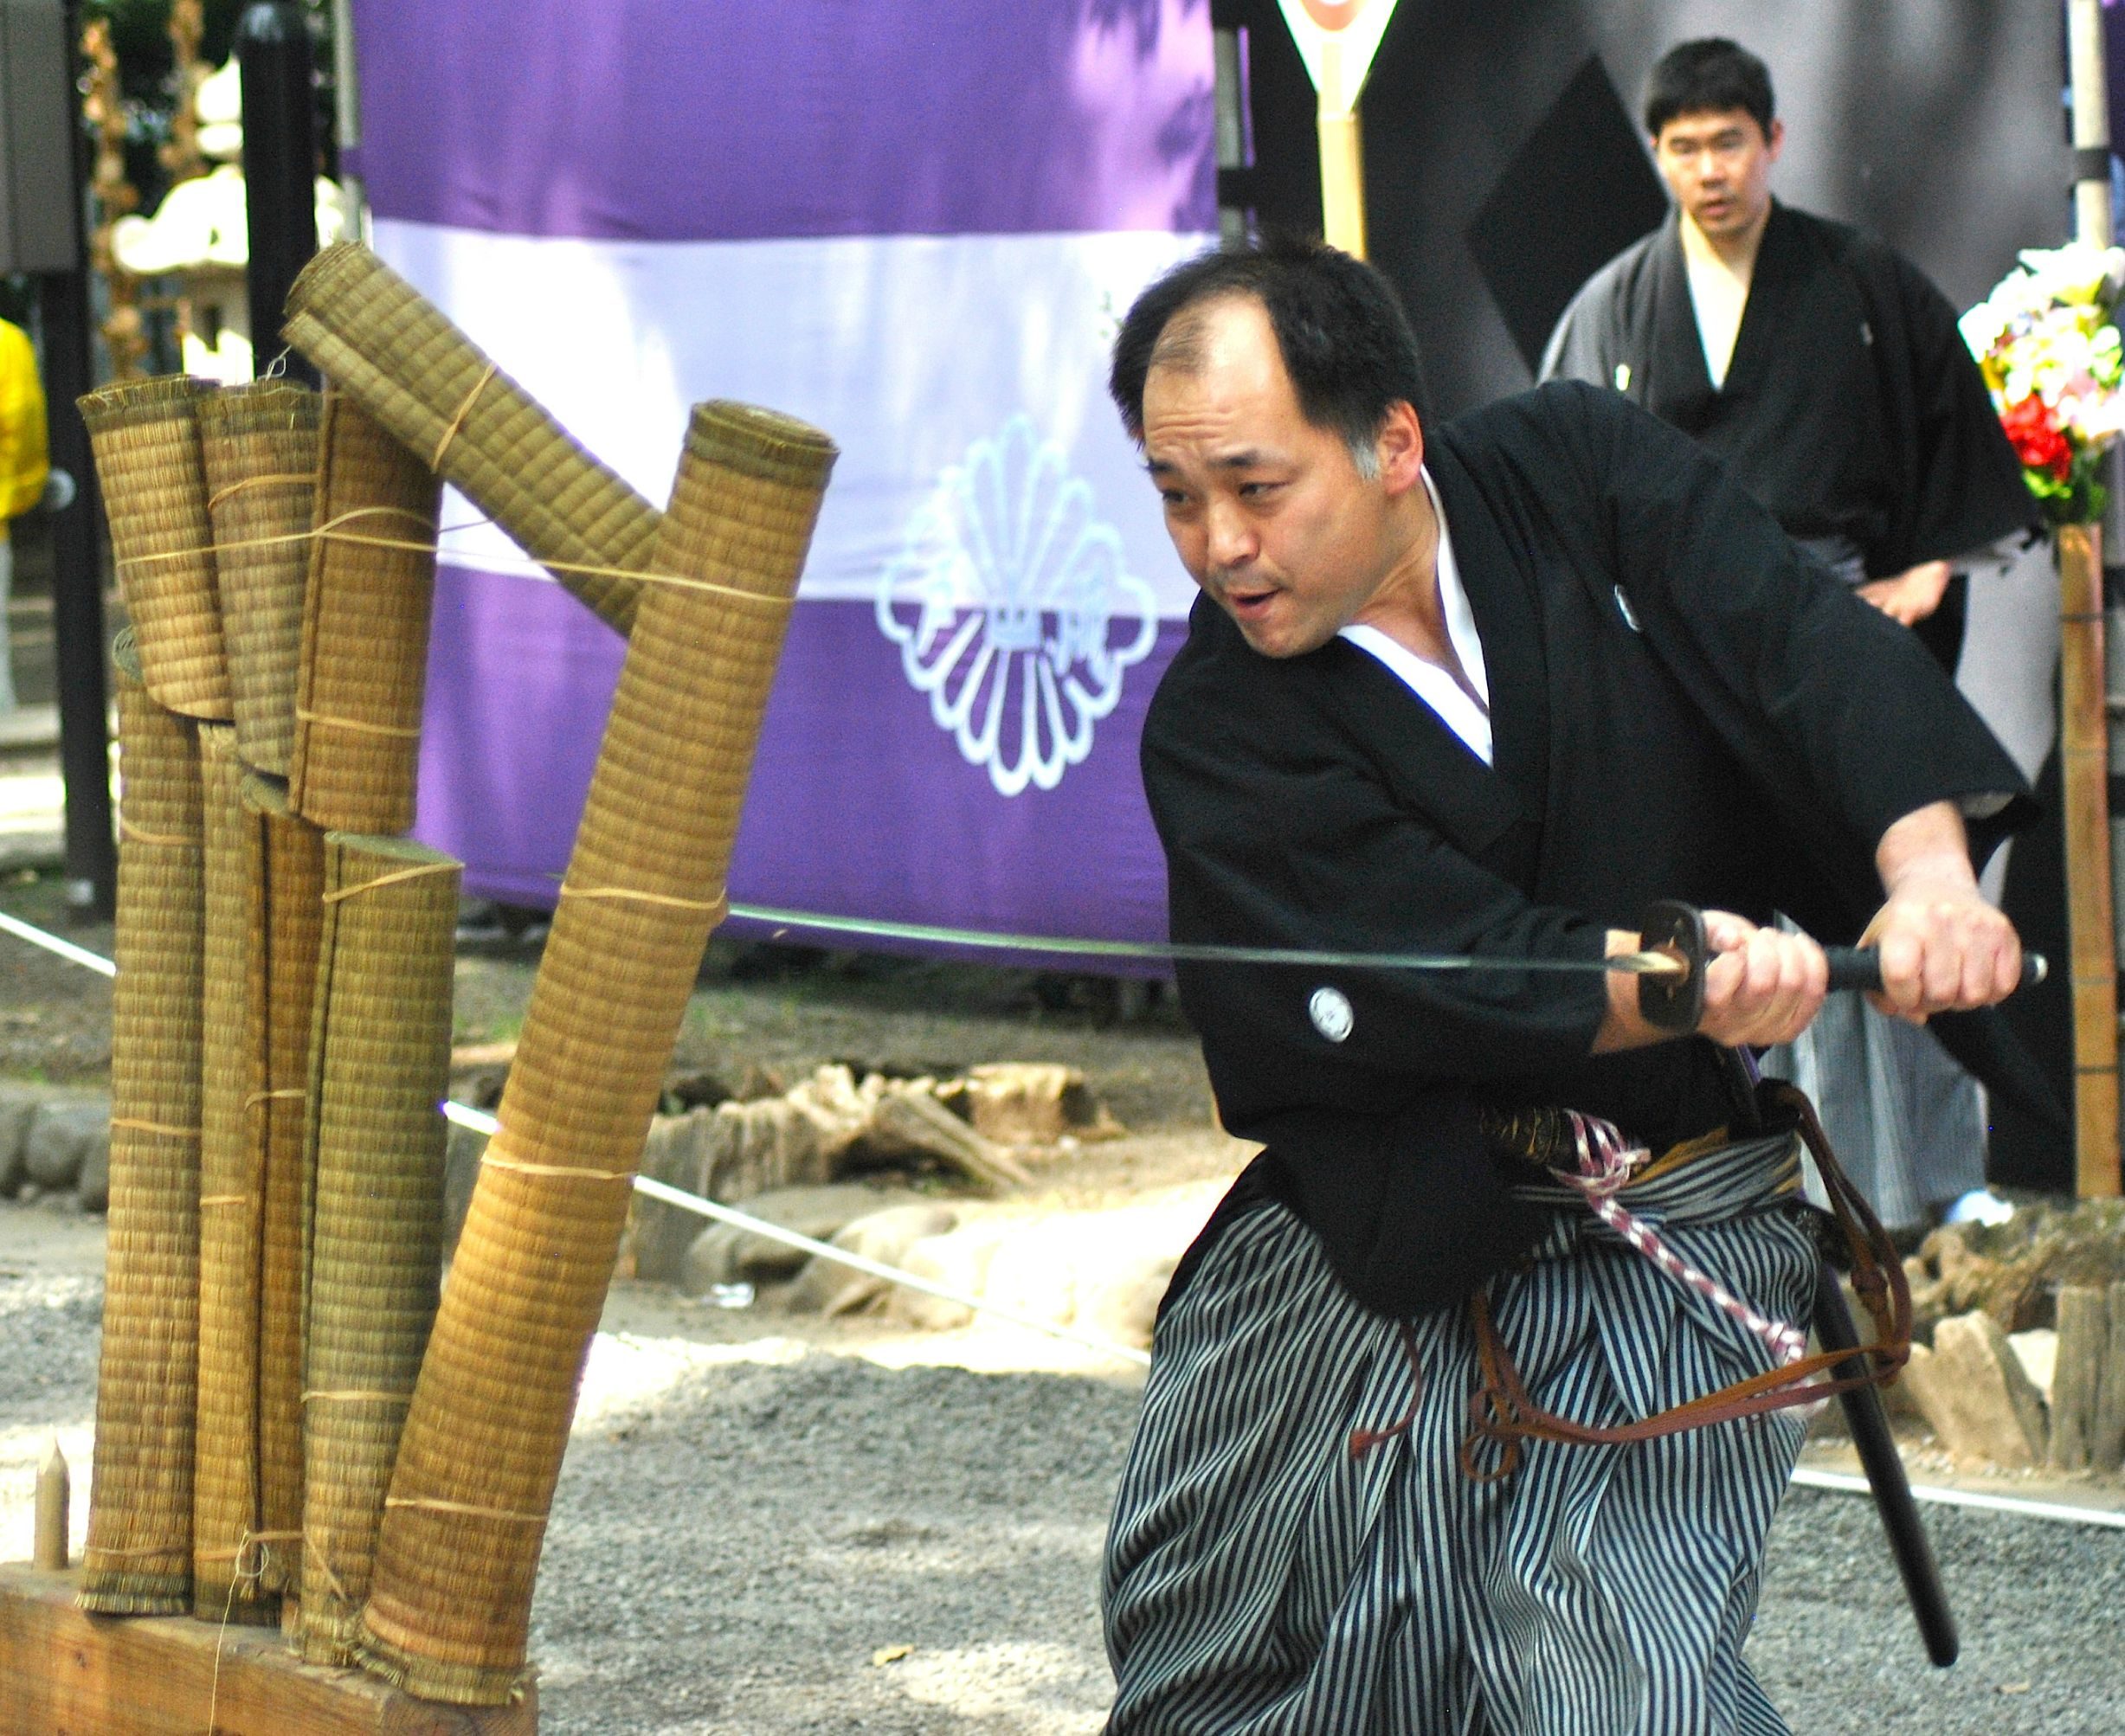
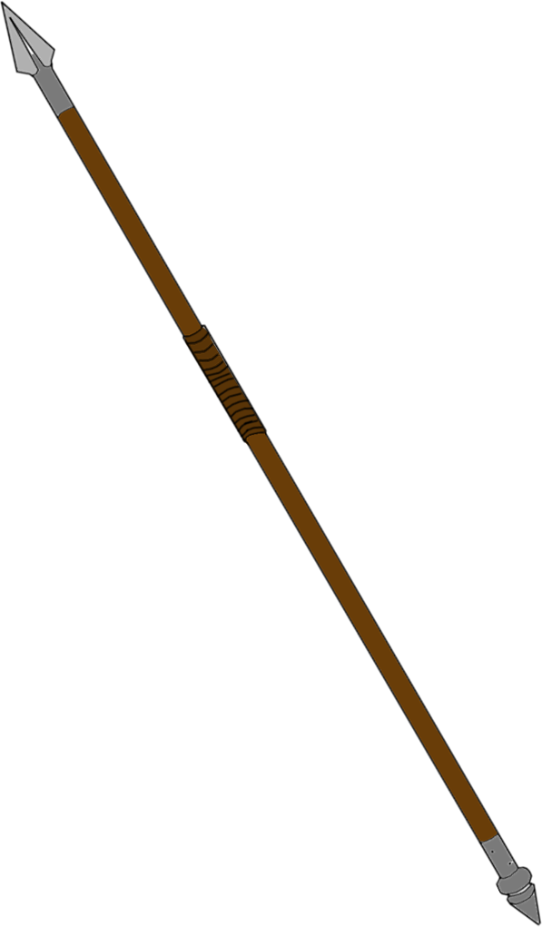
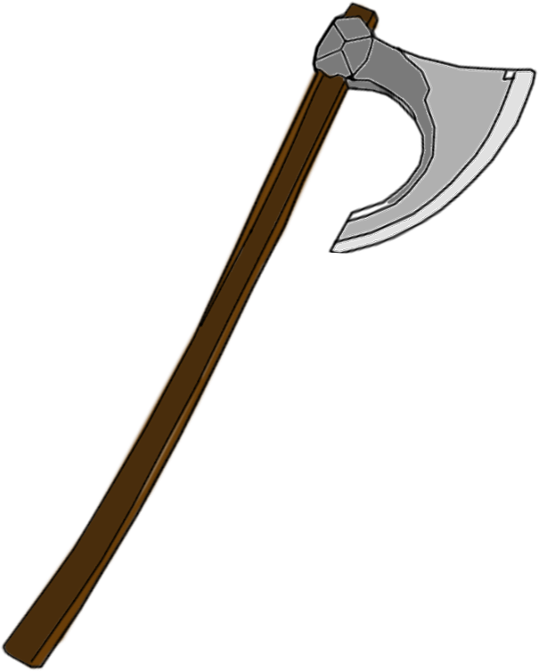
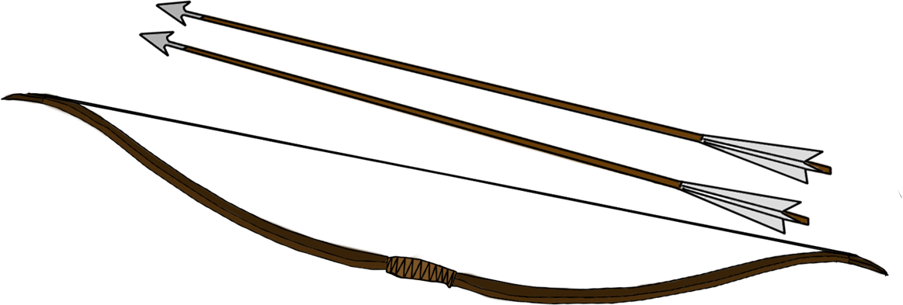
Theme & Aesthetics:
S

Slide 12
Iteration based on recent feedback:
S
Pendulum angle changed from 90 to 40 degrees.
Modifier initial and Maximum speed lowered.
Lowered the maximum amount of rounds to 10
Recoloured Assets to be in contrast with the background

Slide 13
Future improvements:
S
Work on the Visual Hierarchy.
Implement all the assets into the Build.
Implement sound effects.
Finalize the player 2 assets.

Slide 14
ANY QUESTIONS ?

